Slide 1

Regulation of Lobbying Act 2015:
What you need to know
15 September 2022

Slide 2
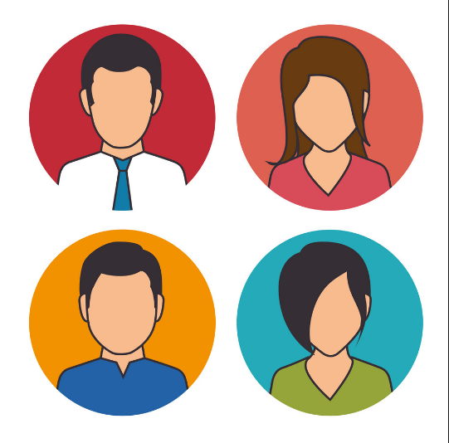
Presentation topics
Overview of Regulation of Lobbying Act 2015
  The Three-Step Test
  Registration and return requirements
  Contraventions and enforcement
How to prepare for compliance
Avoiding common pitfalls
Code of Conduct
Questions

Slide 3
Regulation of Lobbying: Overview of Act
Independent lobbying registrar – Standards Commission
Registration of lobbyists (wide ranging scope)
Regular submission of returns (3 x/year)
Web-based public registry which records; lobbyist, lobbied, subject, intended result
Post-employment restrictions for some public officials
Investigation and enforcement provisions (compliance focus)
Legislative review mechanism
Notes:
Independent lobbying registrar – Standards Commission
Registration of lobbyists (wide ranging scope)
Regular submission of returns (3 x/year)
Web-based public registry (lobbyist, lobbied, subject, intended result)
Post-employment restrictions for some public officials (one year cooling off period in which they cannot lobby)
Only apply to Ministers, Ministers of state, special advisers and civil service
INCLUDES local authority management (CE, Director of Service and Head of Finance in all local authorities; also includes Assistant Chief Executive and Head of Human Resources in Dublin City Council).
DOES NOT INCLUDE elected officials (local councillors)
Investigation and enforcement provisions (compliance focus)
Legislative review mechanism

Slide 4
What is lobbying? The Three-Step Test
Communication must meet the “three step test” to be considered lobbying - communication by:
  Persons within the scope of the Act
  With Designated Public Officials
  On relevant matters
Act makes no distinction regarding method, venue or formality of communication
  Mail, telephone, in-person, email, social media
  Office, social setting, casual encounter, any other

Slide 5
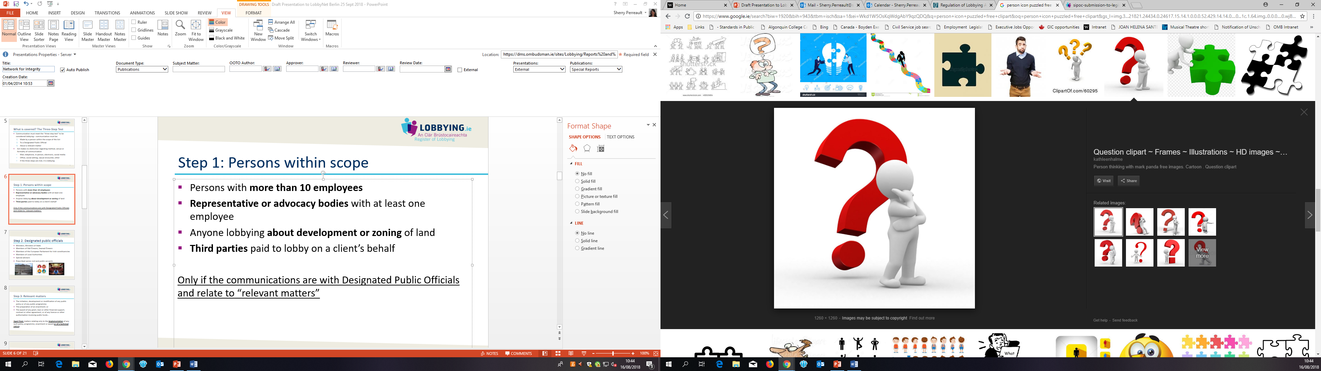
Step 1: Are you within scope of the Act?
Persons with more than 10 employees
Representative or advocacy bodies with at least 1 employee
Third parties paid to lobby on a client’s behalf
Anyone lobbying about development or zoning of land
But even if you meet these criteria you need to register only if the communications are with Designated Public Officials (DPOs) and relate to “relevant matters”

Slide 6
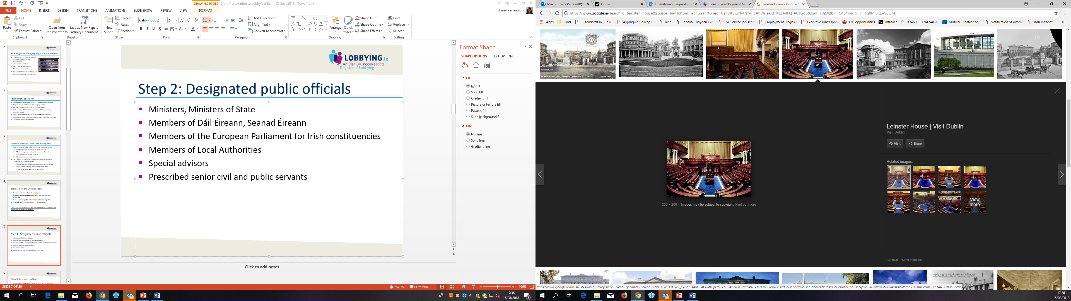
Step 2: Are you communicating with a DPO?
Ministers, Ministers of State
Members of Dáil Éireann, Seanad Éireann
Irish Members of the European Parliament
Members of Local Authorities
Special Advisors
Senior Civil and Public Servants
  Civil service: Secretaries General, Assistant Secretaries, Director grades and equivalent
  Local authorities: Chief Executives , Directors of Service, Heads of Finance, Head of HR (Dublin City Council)
  The Minister may expand group in future (public bodies or levels)

Slide 7
Step 3: Is it about a relevant matter?
The initiation, development or modification of any public policy or of any public programme
The preparation of an enactment
The award of any grant, loan or other financial support, contract or other agreement, or of any licence or other authorisation involving public funds.
Not a relevant matter: Matters relating only to the implementation of any such policy, programme, enactment or award or matters of a technical nature

Slide 8
Exemptions (section 5(5))
Several types of communications are exempt from the requirement to register:
Private affairs
Principal private residence
Diplomatic context
Between public officials
Strictly factual information
Trade union negotiations
Threat to life or safety
Security of the State
Shareholder of State body
Within proceedings of Oireachtas Committee
Information requested and published by public body (Consultations)
Groups established by Public Body where Transparency Code applies (Task forces. Working groups)

Slide 9
Registration requirements
Register after first communication with DPO
Create an account on Lobbying.ie
Include in registration:
  Organisation Name - option to include “trading as” name if different from legal name.
  Business address and contact details
  Main business activities
  Identify person with primary responsibility for lobbying
  Company Registration Office Number or Charitable Registration Number

Slide 10
Return requirements
3 Returns periods per year with mandatory deadlines
  1 September–31 December: returns due 21 January
  1 January–30 April: returns due 21 May
  1 May–31 August: returns due 21 September
Nil returns are also required
One return per subject - include following information:
  Who was lobbied
  Subject matter/intended results
  Type and extent of activity
  Current/former DPOs lobbying for you
  Client information (if relevant; lobbyist)

Slide 11

Contraventions and Enforcement
Contraventions of Act:
  Lobbying without registering
  Failure to submit return by deadline (including nil return)
  Providing inaccurate/misleading information
  Failing to comply with an investigation
  Obstructing an investigation
Consequences of non-compliance
  Fixed payment notices for late returns: €200
  Investigation and prosecution of contraventions
  If convicted: higher fines and/or imprisonment

Slide 12
Preparations for Compliance
Review your organisation’s arrangements for recording relevant communications
Identify individual(s) responsible for registration and compilation of returns.
  Data can be entered on the register on an ongoing basis by more than one employee and saved in draft form (on a private area of the register) prior to its formal submission.
Nominate compliance officer
  Single person responsible for reviewing all final returns for completeness, accuracy and consistency
  Person can submit final return at the end of each reporting period
  Make sure that person has a backup!

Slide 13
Avoiding common pitfalls
Should you register? Do the three-step test
Register once you commence lobbying
Track your lobbying activity with an eye to returns
  One return per subject, not for every communication
Meet the deadlines
  21 January, 21 May, 21 September: mandatory deadlines
  Nil returns are also expected – Very important!
  Have organisational backups- Admin & Users
Make returns meaningful
Indicate if you have ceased lobbying

Slide 14
Code of Conduct
Eight Principles of Code:
1) Demonstrate respect for public bodies
2) Act with honesty & integrity
3) Ensure accuracy of Information
4) Disclose identity and purpose
5) Preserve confidentiality
6)Avoid improper influence
7) Observe provisions of Act
8) Observe provisions of code
Came into effect 1 January 2019
Purpose to govern behaviour – ensure lobbying ethical
Sets out 8 key principles
Persons lobbying should have regard to Code

Slide 15
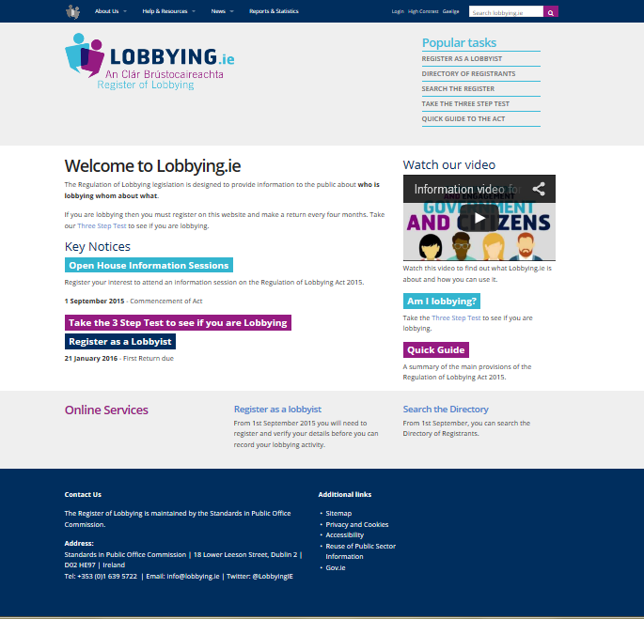
Thank you/Questions?
Visit our website:
www.LOBBYING.ie
Notes:
QUESTIONS?

